Slide 1
The Printout Queue and Quick Printing in Alma
Yoel Kortick
Senior Librarian

Slide 2

Agenda
Introduction
Setting up a "Printout Queue" Printer
Defining the printer current location
Sending a letter to the "Printout Queue"
Using the "Printout Queue"
Using the "Enable quick printing"

Slide 3
Introduction

Slide 4
Introduction
It is possible to define a printer as a "Printout Queue" and also to "Enable quick printing".
When a letter will be "Printed" and the "Printout Queue" printer is in use, printed letters are sent to a queue from which the letter can later be previewed and printed to an "actual physical" printer.
When "Enable quick printing" is in use and a letter is printed a dialog box pops up. From the browser printer dialog box, it is possible to directly print the letter to an "actual physical" printer defined on the PC and preview the letter.

Slide 5
Introduction
This functionality differs from other printing-related functionality present in Alma, whereby all printouts are sent to an email address and then either:
  The letter is printed because the printer is defined to have an email address.
  A third-party tool such as Namtuk or Thunderbird can be employed to send the email to an "actual physical" printer.
Further, the Printout Queue and Quick Printing provide an option to view what was printed and "on demand" preview it or print it again.

Slide 6
Introduction
This functionality is relevant for letters which are, by design and purpose, intended to go to an actual physical printer.
For example:
  It is possible to send the letter "Resource Request Slip Letter" to the "Printout Queue" because this is designed to be printed to a piece of paper and then attached to the resource while it waits on the hold shelf.
  It is not possible to print the "Order Claim Letter" to the "Printout Queue" because this is designed to be sent by email to a vendor, and not to paper.

Slide 7
Introduction
Here are the letters which can be sent to the "Printout Queue":
Loan Receipt letter
  Printed when the Circulation Desk configuration has "Creates loan receipts" and an item is loaned and staff user clicks "Done"
Return Receipt Letter
  Printed when the Circulation Desk configuration has "Creates return receipts" and an item is returned and staff user clicks "Exit"
Hold Shelf Request Slip Letter
  Printed when an item which has a hold request is scanned in at the circulation desk
Resource Request Slip Letter.
  Printed when staff user does "Fulfillment > Resource Requests > Scan In Items" and then scans an item barcode and chooses "Print Slip". Also printed from the "Pick from Shelf" list.
Fine Fee Payment Receipt Letter.
  Printed when staff user does "Fulfillment > Checkout / Checkin > Manage Patron Services" and then retrieves a patron and clicks "Pay"
Ful Transit Slip Letter
  Printed in multiple scenarios whereby an item is scanned in at the circulation desk of one library and must go to another library, for example due to a physical item request for pickup at a different library than the owning library

Slide 8
Introduction
The printing capabilities we will show and use here are dependent on the web browser.
Therefore, much of what will be shown here depends on
Which internet browser and browser version you are using
What setup you have in the internet browser
If what you see is not 100% identical to what is shown here that is "normal".
In the examples here we are using Firefox with default out of the box settings.

Slide 9
Setting up a "Printout Queue" Printer

Slide 10
Setting up a "Printout Queue" Printer
The library manager can setup one or more printers per department/circulation desk as
An email printer
A "Printout Queue"
Both of the above

Slide 11
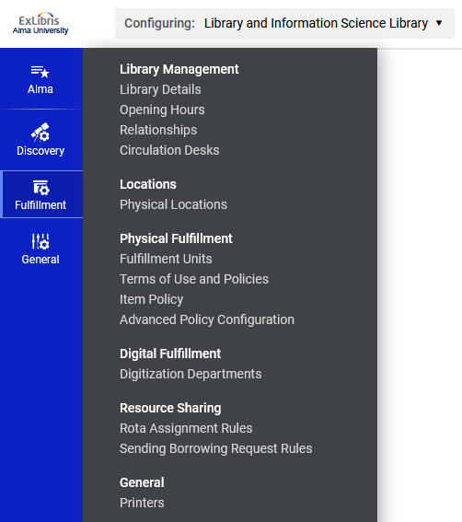
Setting up a "Printout Queue" Printer
While at the "Library and Information Science Library" we will access the printers.
This is done at "Configuration > Fulfillment > General > Printers"

Slide 12
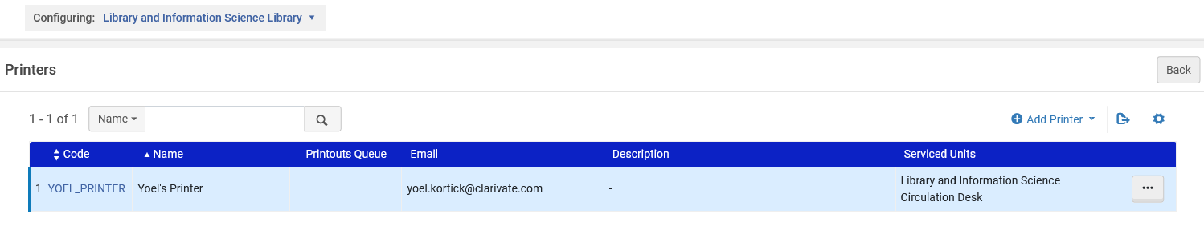
Setting up a "Printout Queue" Printer
We will add a printer which will be defined (on the next slides) as a "Printout Queue"

Slide 13
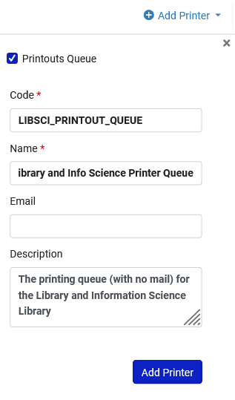
Setting up a "Printout Queue" Printer
Checkbox signifying that this is a "Printout Queue"
The printer is named "Library and Info Science Printer Queue".
When "Printout Queue" is checked the field "email" is optional.

Slide 14
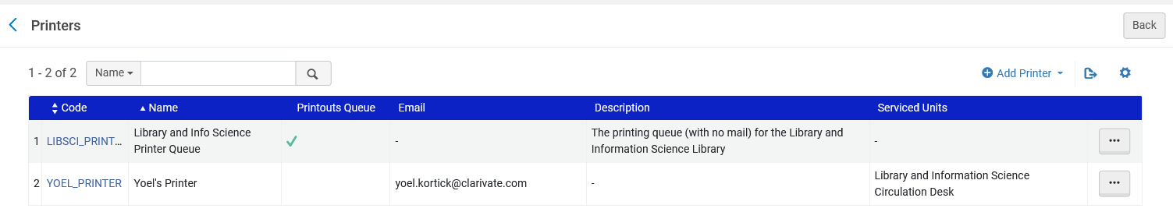
Setting up a "Printout Queue" Printer
Here is the new "Printout Queue" printer

Slide 15
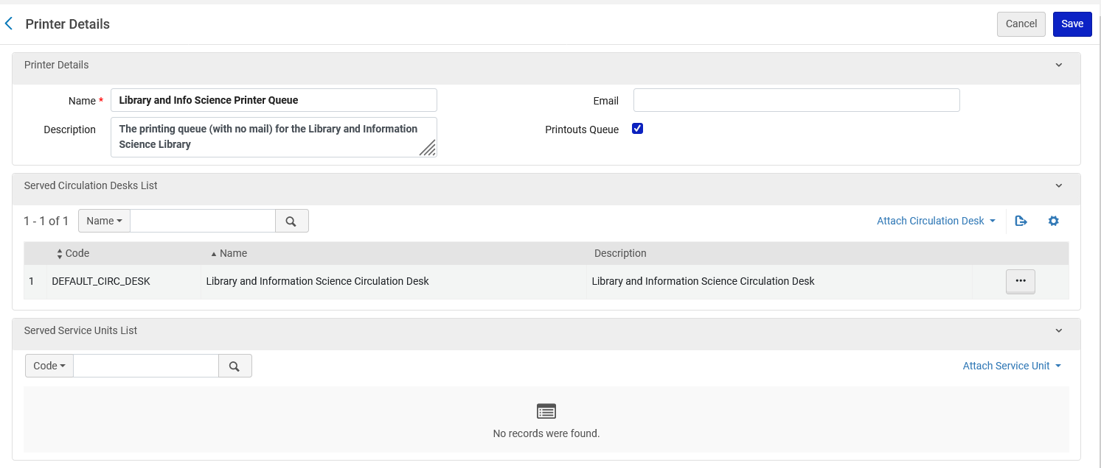
Setting up a "Printout Queue" Printer
Here is the new "Printout Queue" printer

Slide 16
Setting up a "Printout Queue" Printer
When "Printout Queue" is checked:
  If there is no email, then the printout will go only to the "Printout Queue"
  If there is an email, then the printout will go to the "Printout Queue" and to the email.
When "Printout Queue" is not checked:
  Email is required and printout is sent to the email.

Slide 17
Setting up a "Printout Queue" Printer
We will associate the "Printout Queue" printer with a relevant circulation desk.
This is done at "Configuration > Fulfillment > Library Management > Circulation Desks"

Slide 18
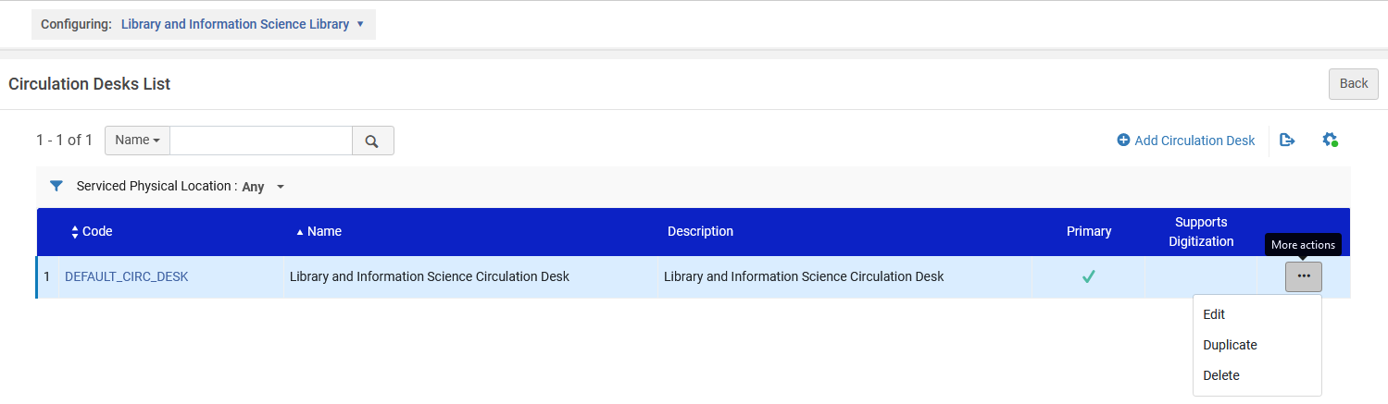
Setting up a "Printout Queue" Printer
We will edit the default circulation desk

Slide 19
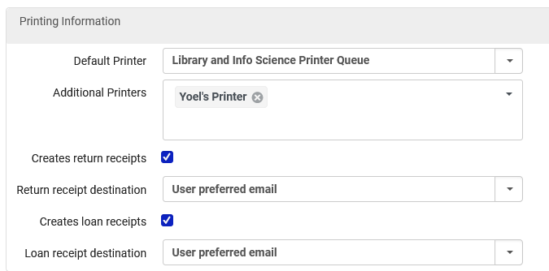
Setting up a "Printout Queue" Printer
In the "Printing Information" section of the circulation desk (in the "General Details" tab) we have made the "Default Printer" be the "Printout Queue" printer which we previously defined at "Configuration > Fulfillment > General > Printers".
This is the "Printout Queue" printer which we previously defined.

Slide 20
Defining the printer current location

Slide 21
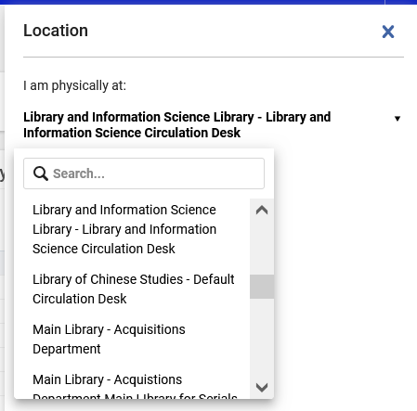
Defining the printer current location
Per location the staff user can choose which printer will be used for printing.
For example, now the staff user is "Currently At" the "Library and Information Science Library Circulation Desk" …

Slide 22
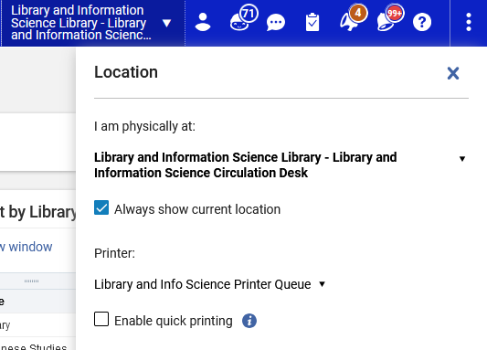
Defining the printer current location
Click the small triangle to the right of the circulation desk name to define the printer.

Slide 23
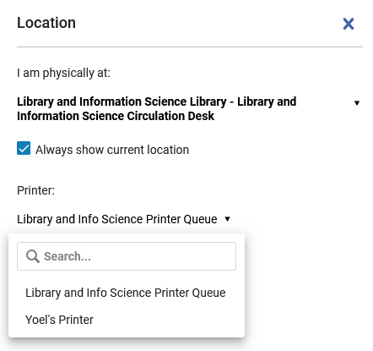
Defining the printer current location
The staff user at the "Library and Information Science Library Circulation Desk" has chosen the printer defined earlier named "Library and Info Science Printer Queue"

Slide 24
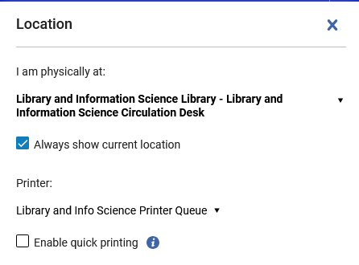
Defining the printer current location
Note that we have not checked "Enable quick printing". More on that topic later.
If there is only one printer associated with the circulation desk, then there will not be prompt to choose printer

Slide 25
Sending a letter to the "Printout Queue"

Slide 26
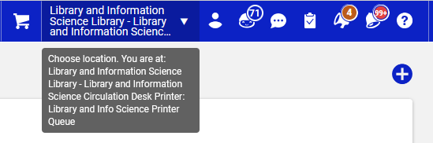
Sending a letter to the "Printout Queue"
The staff user is at the "Library and Information Science Library Circulation Desk" and has chosen the printer defined earlier named "Library and Info Science Printer Queue"
Hover mouse over the triangle to see details

Slide 27
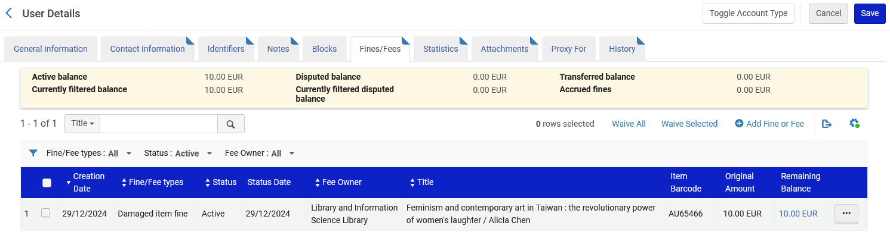
Sending a letter to the "Printout Queue"
Patron Alicia Chen has a fine of 10.00 EUR

Slide 28
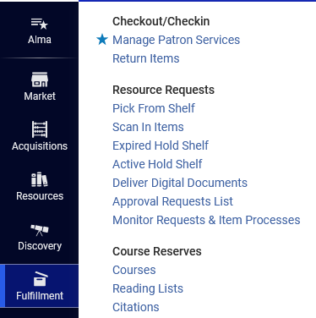
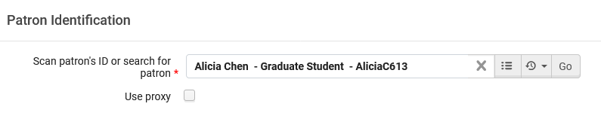
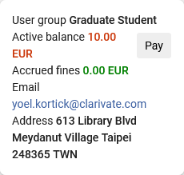
Sending a letter to the "Printout Queue"
Let’s scan in the patron and click "Pay".

Slide 29
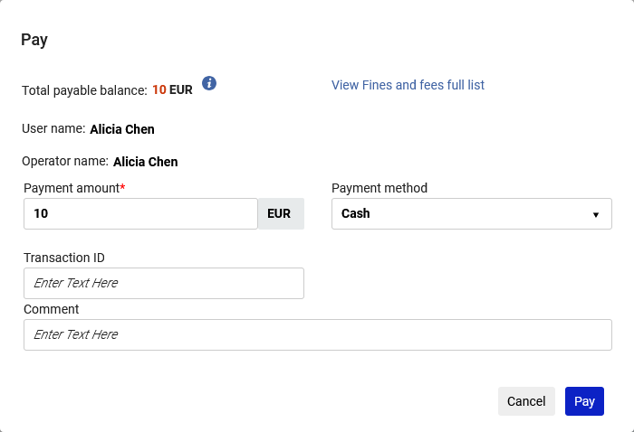
Sending a letter to the "Printout Queue"
Fill in payment details as desired and click and "Pay"

Slide 30
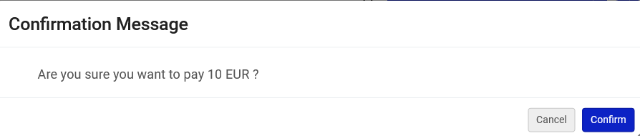
Sending a letter to the "Printout Queue"
Confirm

Slide 31

Sending a letter to the "Printout Queue"
Receive confirmation that payment was made

Slide 32
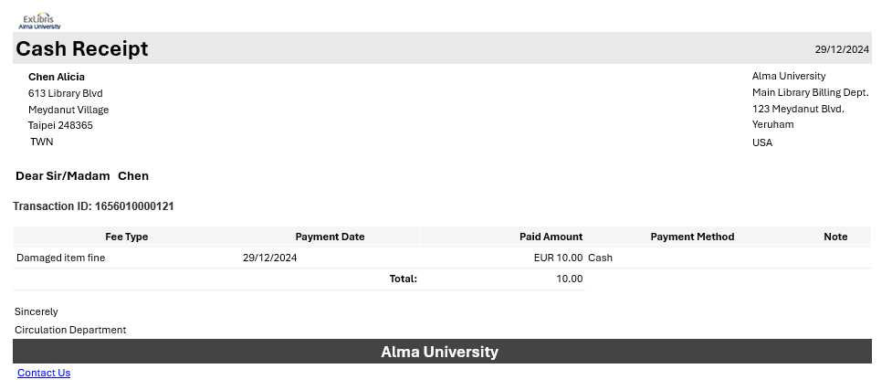
Sending a letter to the "Printout Queue"
The patron receives the receipt via email

Slide 33
Using the "Printout Queue"

Slide 34
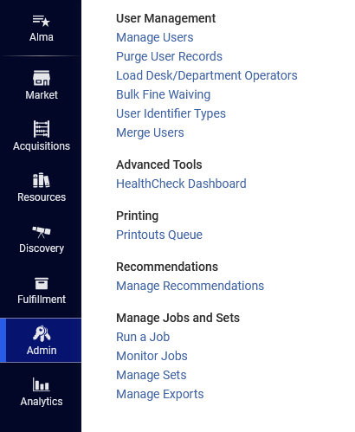
Using the "Printout Queue"
The letter which was just printed went to the "Printout Queue" where it can be previewed and printed again.
Now we will access the Printouts Queue at "Admin > Printing > Printouts Queue"

Slide 35
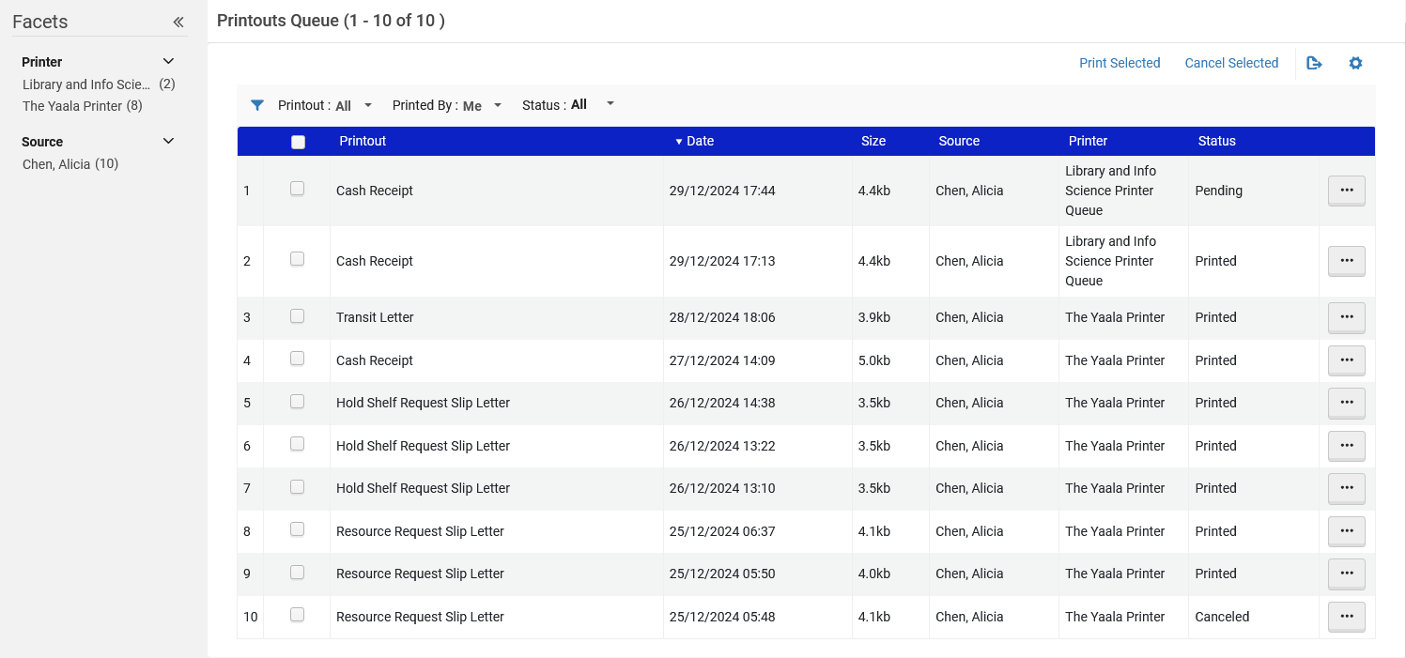
Using the "Printout Queue"
Printouts will remain here for 7 days and then are automatically removed
Can be multiselected and printed
Can be faceted by printer and source
Some letters may be in status "Pending" because we did not really print them (to a printer)

Slide 36
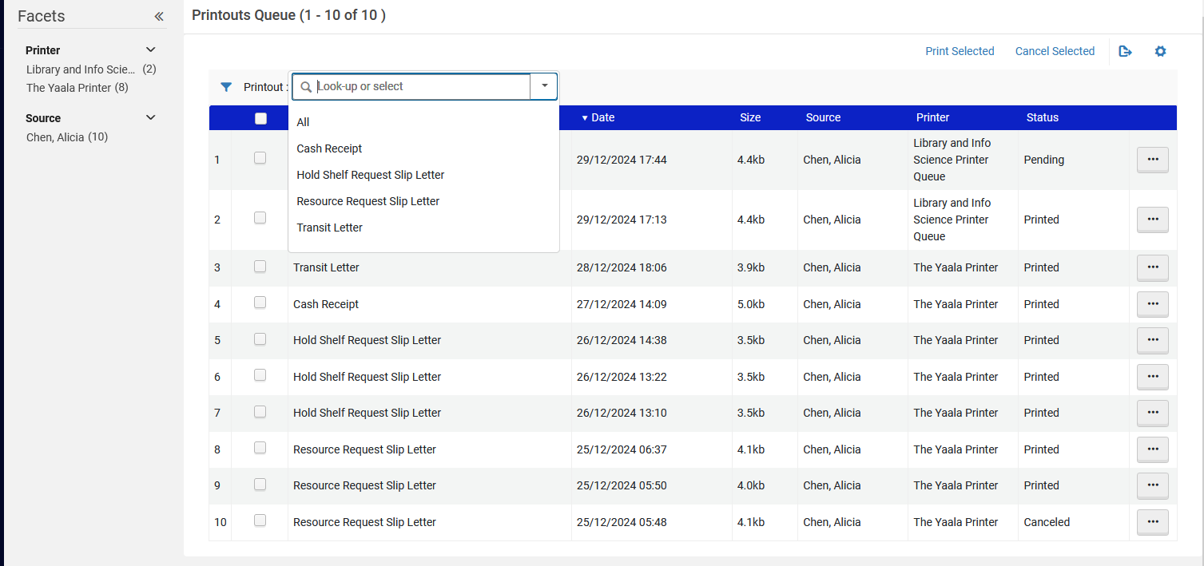
Using the "Printout Queue"
The Printouts can be filtered by Letter Name

Slide 37
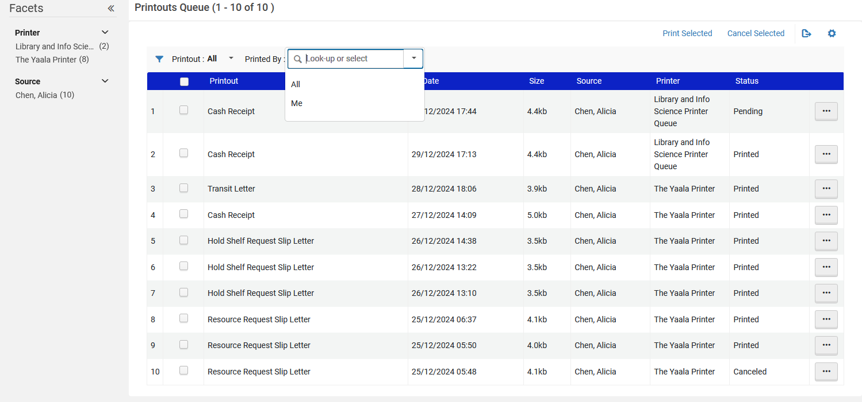
Using the "Printout Queue"
The printouts can be filtered by all or just mine

Slide 38
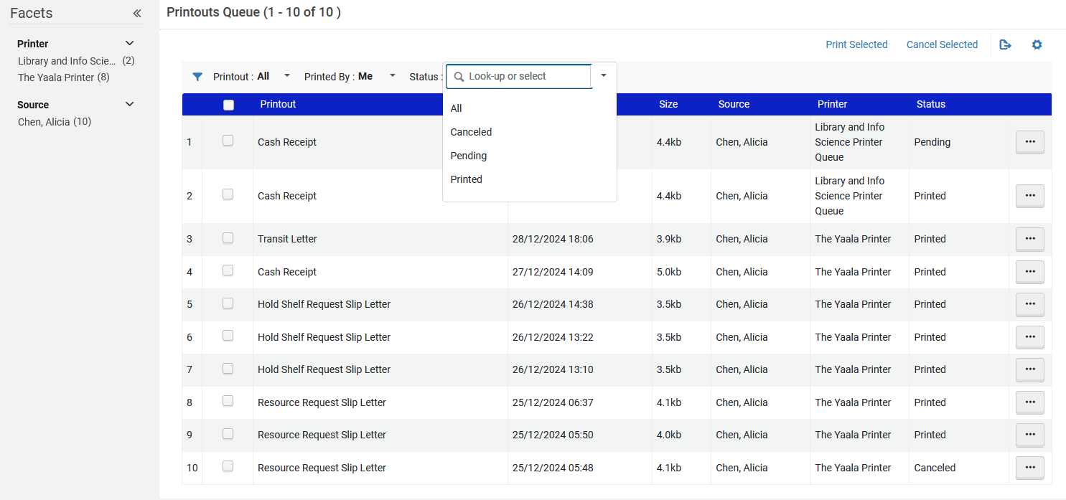
Using the "Printout Queue"
The printouts can be filtered by status

Slide 39
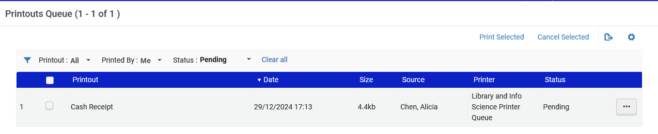
Using the "Printout Queue"
We can see the letter which was sent to the patron.
It is in the Printouts Queue (currently in status "Pending")

Slide 40
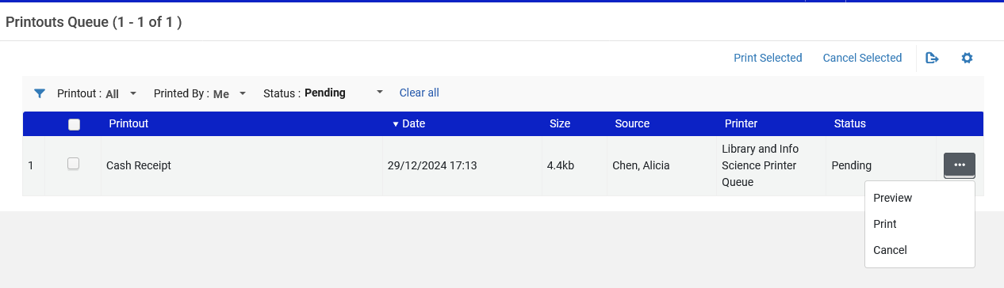
Using the "Printout Queue"
From the Printouts Queue we can Preview, Print or Cancel the letter.
We will click "Print"

Slide 41
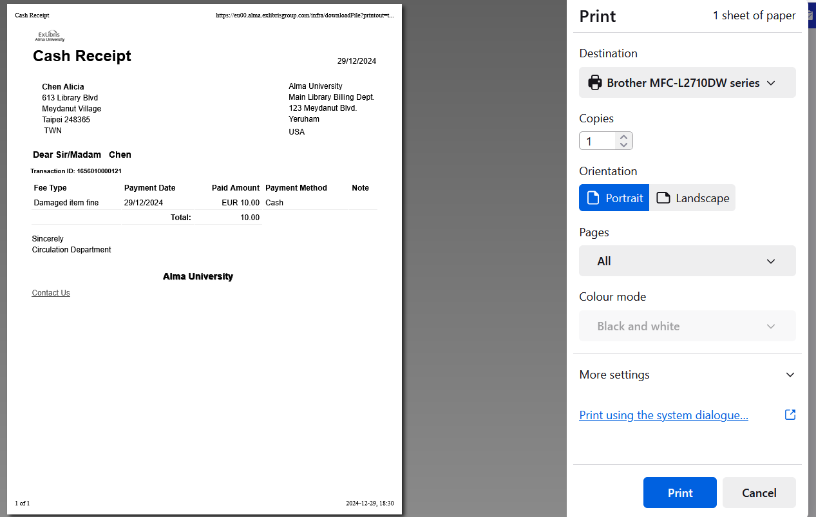
Using the "Printout Queue"
Now we have a preview of the letter and can print it or save as PDF (depending on the chosen "Destination")
We will print the letter

Slide 42
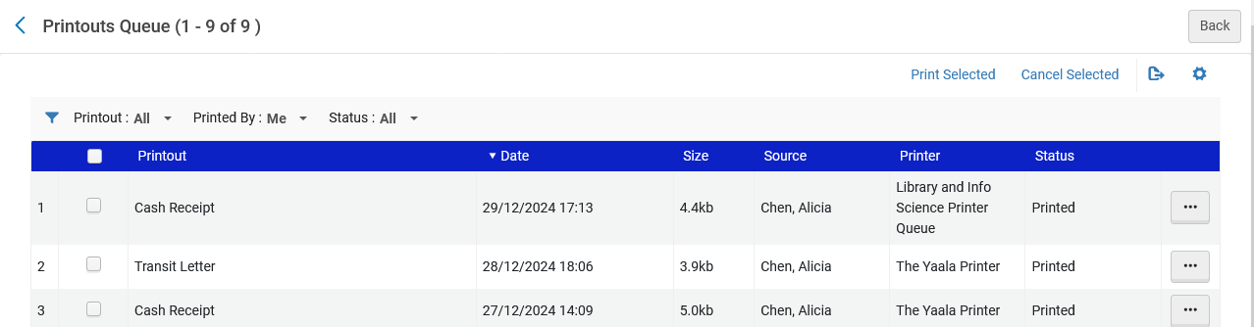
Using the "Printout Queue"
The status of the letter has changed to "Printed"

Slide 43
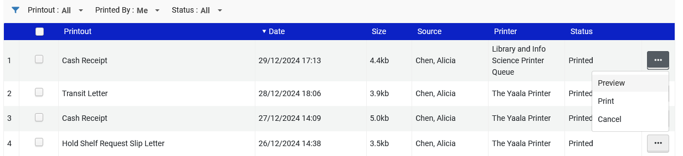
Using the "Printout Queue"
After it is printed, we can still Preview, Print or Cancel the letter.

Slide 44
Using the "Enable quick printing"

Slide 45
Using the "Enable quick printing"
Now we will define in the "Currently at" that we will use our "Printout Queue" printer with option "Enable Quick Printing".
This causes the print dialog box to automatically open in the browser when a letter is printed.
There is no need for user to manually click another link.

Slide 46
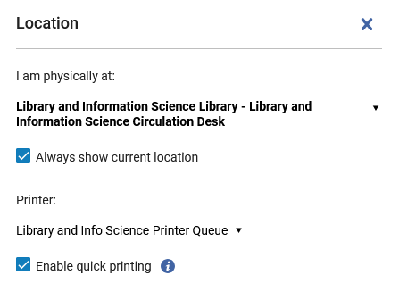
Using the "Enable quick printing"
"Enable quick printing"

Slide 47
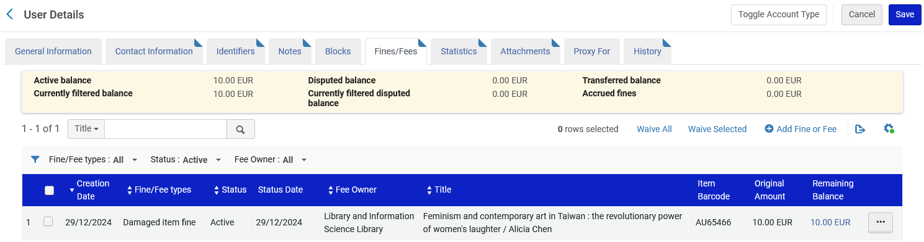
Using the "Enable quick printing"
Again, patron Alicia Chen has a fine of 10.00 EUR

Slide 48
Using the "Enable quick printing"
Let’s scan in the patron and click "Pay".

Slide 49
Using the "Enable quick printing"
Fill in payment details as desired and click and "Pay"

Slide 50
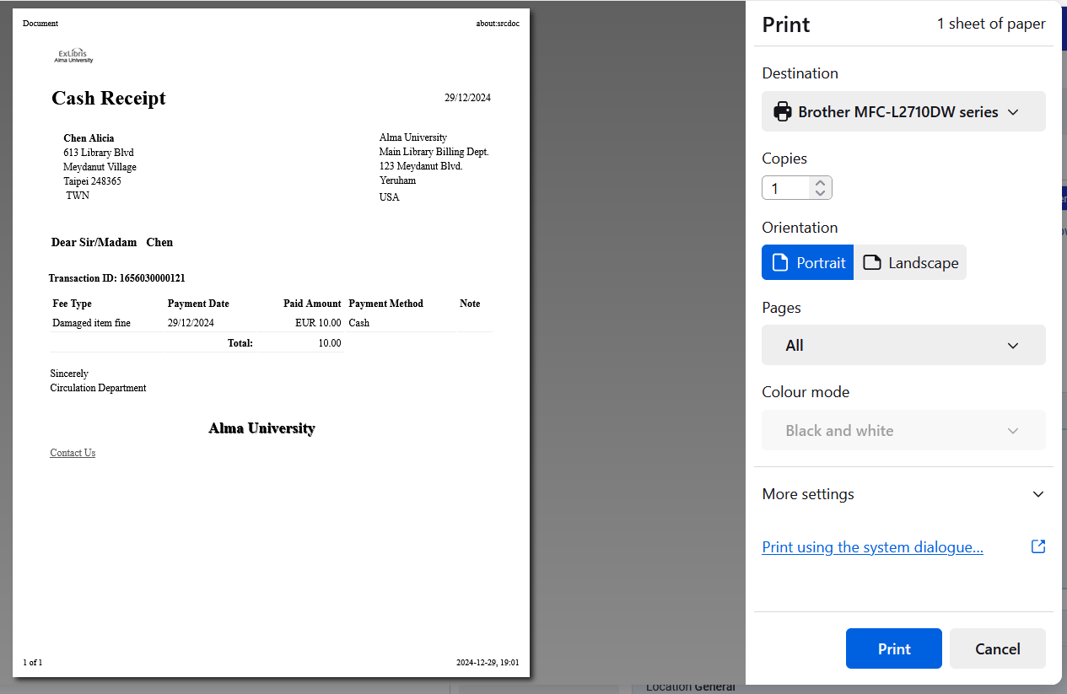
Using the "Enable quick printing"
Because we have selected option "Enable Quick Printing" the print dialog box automatically opens when, for example, the Cash Receipt is printed. We do not need to go to the Printouts Queue to print it to a printer or save as a PDF. The letter is also still sent by email to the patron.

Slide 51
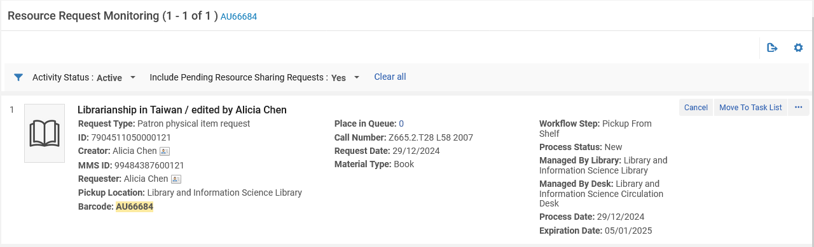
Using the "Enable quick printing"
Item barcode AU66684 has a physical item request

Slide 52
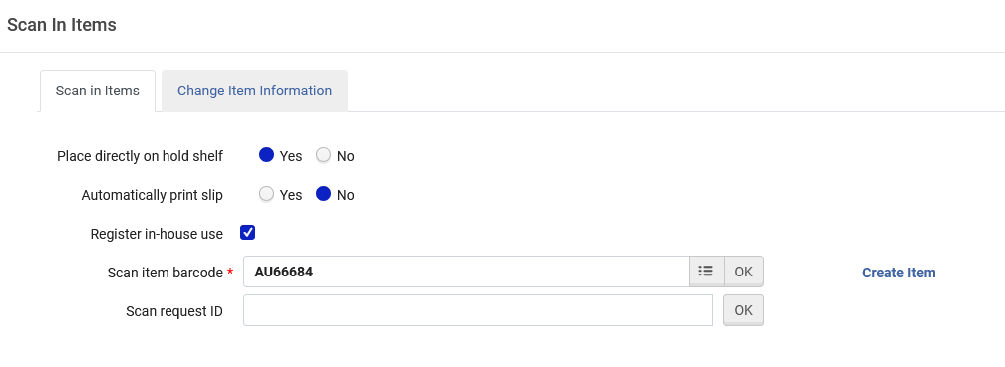
Using the "Enable quick printing"
Now, still with "Enable Quick Printing" checked, we will scan in the item which has a physical item request on it.

Slide 53
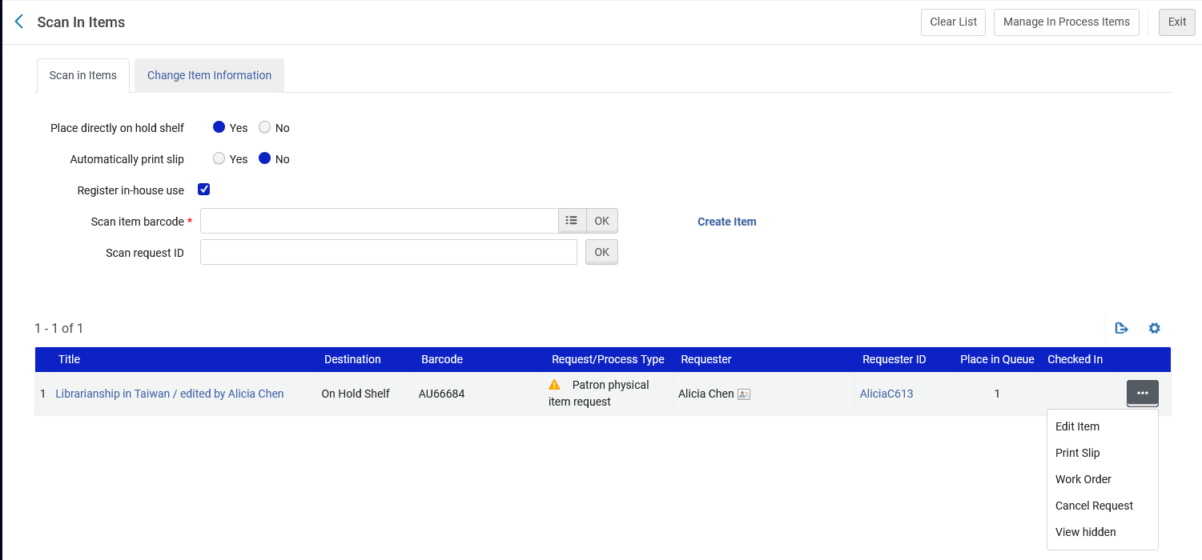
Using the "Enable quick printing"
We will print the slip

Slide 54
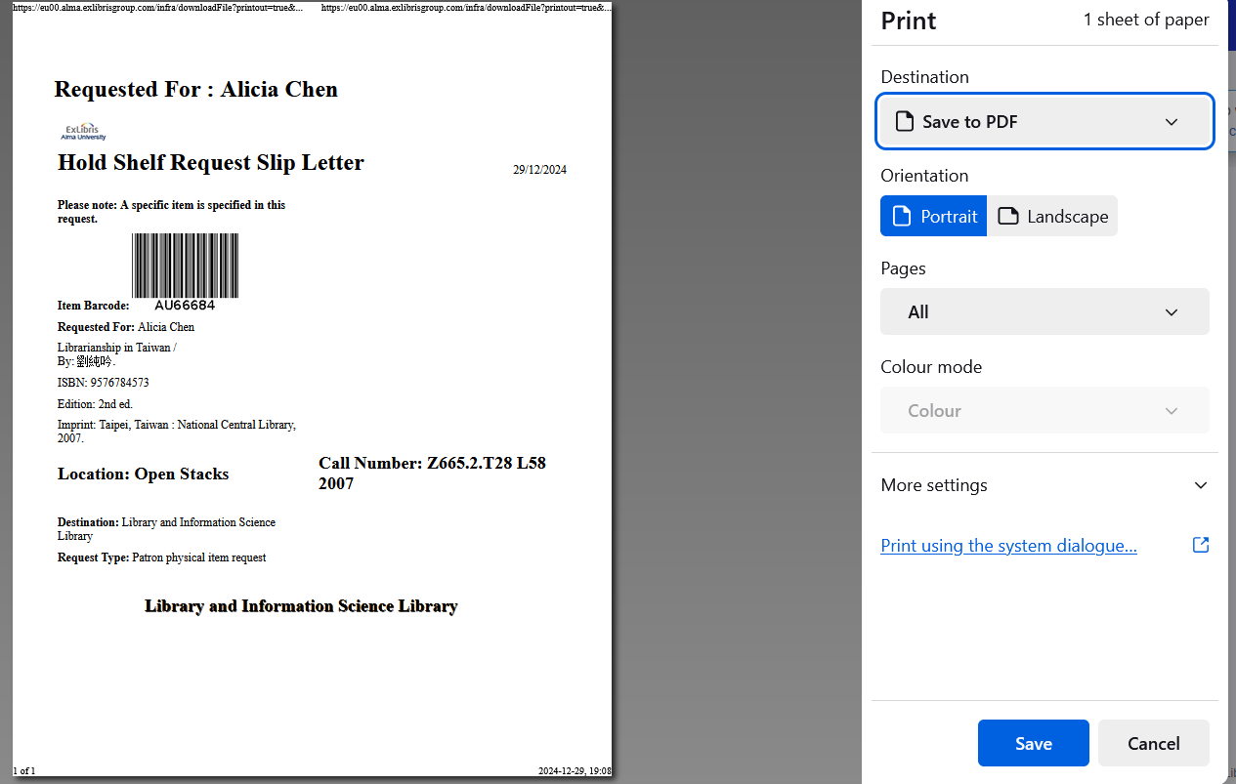
Using the "Enable quick printing"
Because we have selected option "Enable Quick Printing" the print dialog box automatically opens when, for example, the Hold Shelf Request Slip Letter is printed. We do not need to go to the Printouts Queue to print it to a printer or save as a PDF.

Slide 55
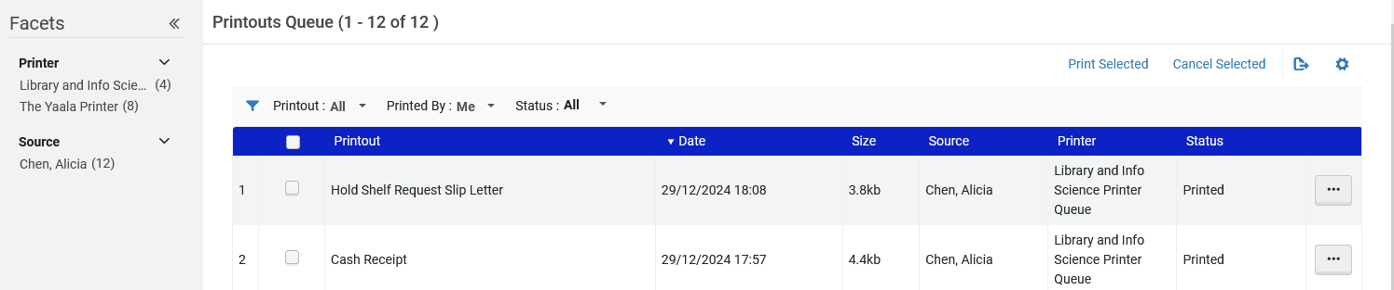
Using the "Enable quick printing"
These last two letters (Hold Shelf Request Slip Letter and Cash Receipt) were also sent to the Print Queue.
Letters are sent to the Print Queue regardless of whether "Enable quick printing" is checked.

